Slide 1
Data Input and Augmentation using Keras for Object Classification
Matthew Kutugata

Slide 2
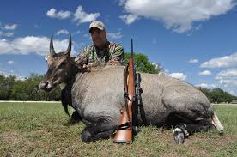
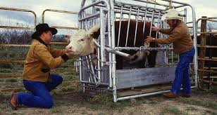

Problem:
Complex Nilgai cattle-tick eradication project
Trail cam data
Primed for computer vision solution

Slide 3
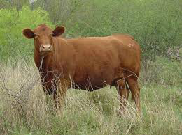
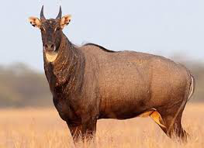
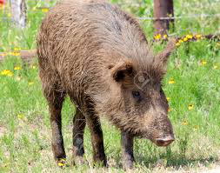
Object Classification
cow
nilgai
pig
3 classes

Slide 4
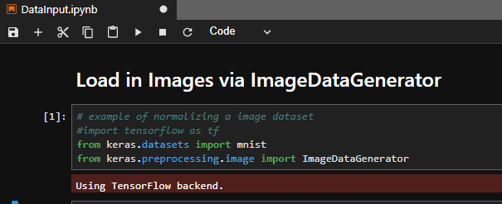
Keras and Tensorflow 2 as a “backend”
Keras is an open-sourced neural-network library written in Python
Provides high-level building blocks for deep learning models
Keras does not handle low-level operations
It relies on a specialized tensor manipulation library to do so, serving as the "backend engine" of Keras
Allows developers to focus on high-level development

Slide 5

Why is “Data input” a thing?
Unstructured data (images) and labels
100 – 100,000 example dataset difficult to organize
Automatic generation of train, validation, and test sets
Progressive loading of image data that may not fit in system memory
Organizing
Loading
Preprocessing
Notes:
Pre-processing should be last item so that you can get into “packaging” of dataset and into a datainput pipeline.

Slide 6
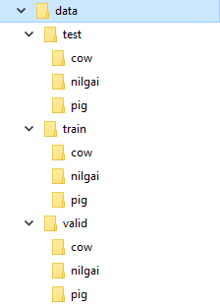
Organize train, validation, and test image datasets
Training set: examples used for learning - to fit the parameters of the classifier
Validation set: examples used to finetune the parameters of a classifier
Test set: examples used only to assess the performance of a fully-trained classifier (5 images)
5 images/class
20 images/class
5 images/class
— Brian Ripley, page 354, Pattern Recognition and Neural Networks, 1996

Slide 7
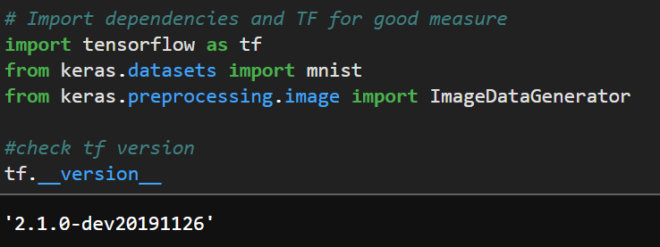
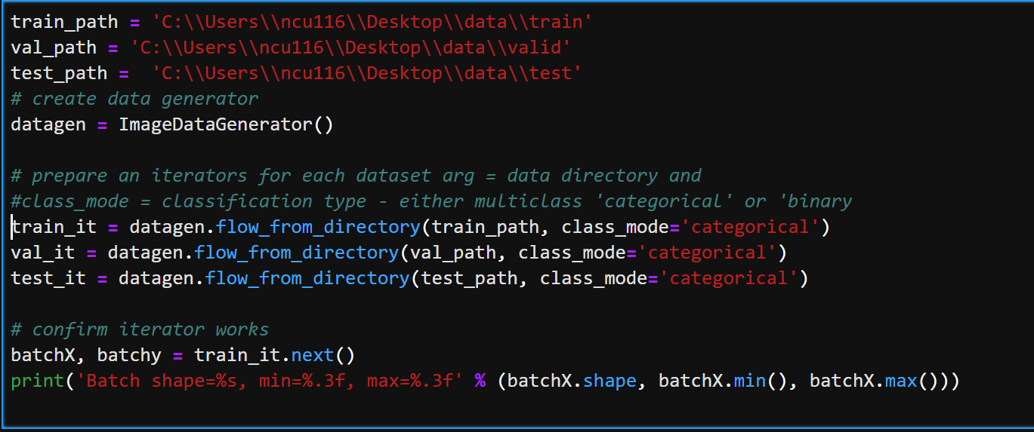
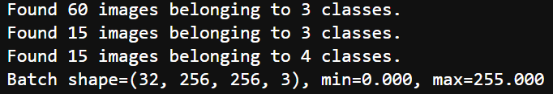
Loading data using ImageDataGenerator
ImageDataGenerator()
Generate batches of tensor image data with on-the-fly data augmentation. The data will be looped over (in batches).
flow_from_directory
Reads images from folders

Slide 8
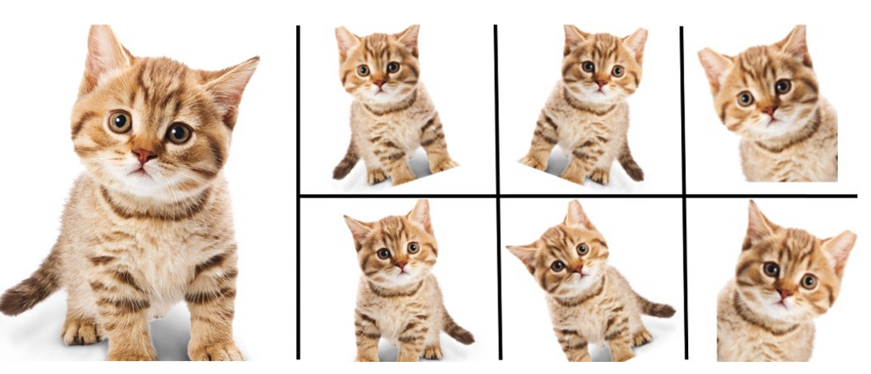
What is and Why use Data Augmentation?
Technique used to artificially expand size of training set
Training on more data results in more accurate models
Augmentation creates variations of images that can improve the ability of a model to generalize on new images
Image augmentation in Keras is performed using
ImageDataGenerator() class

Slide 9
Data Augmentation Types
Horizontal/Vertical shift
Horizontal/Vertical flip
Random rotation
Random brightness
Random zoom

Slide 10
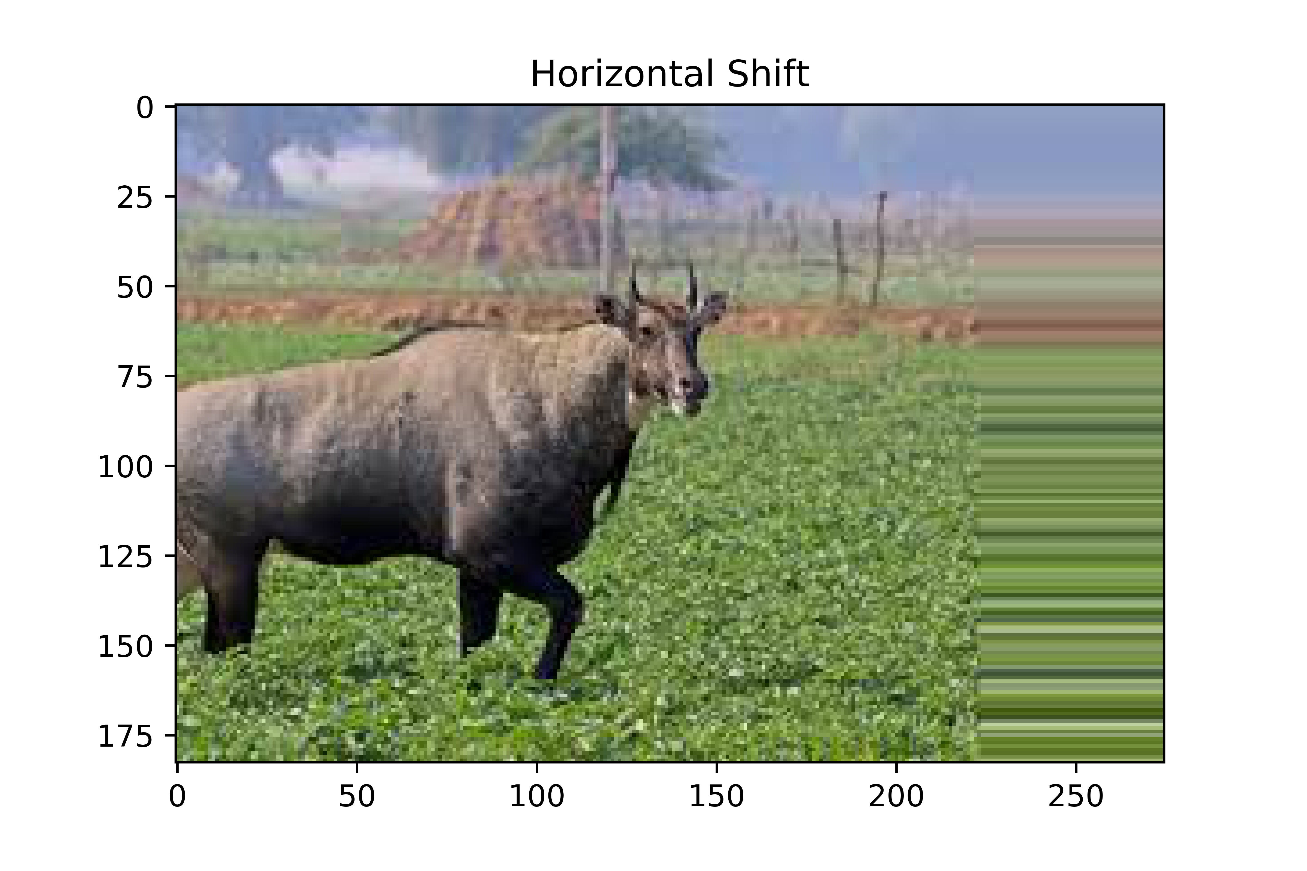
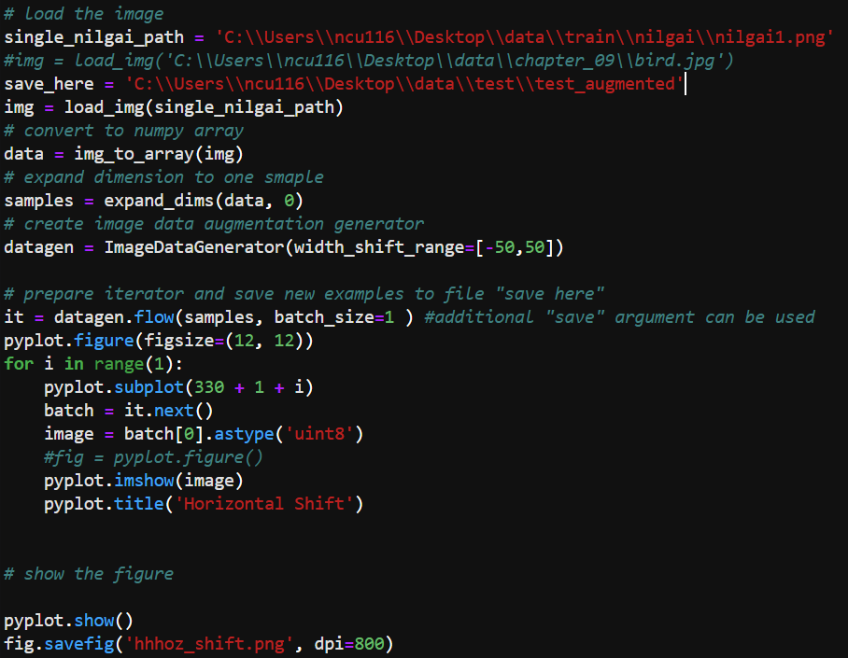
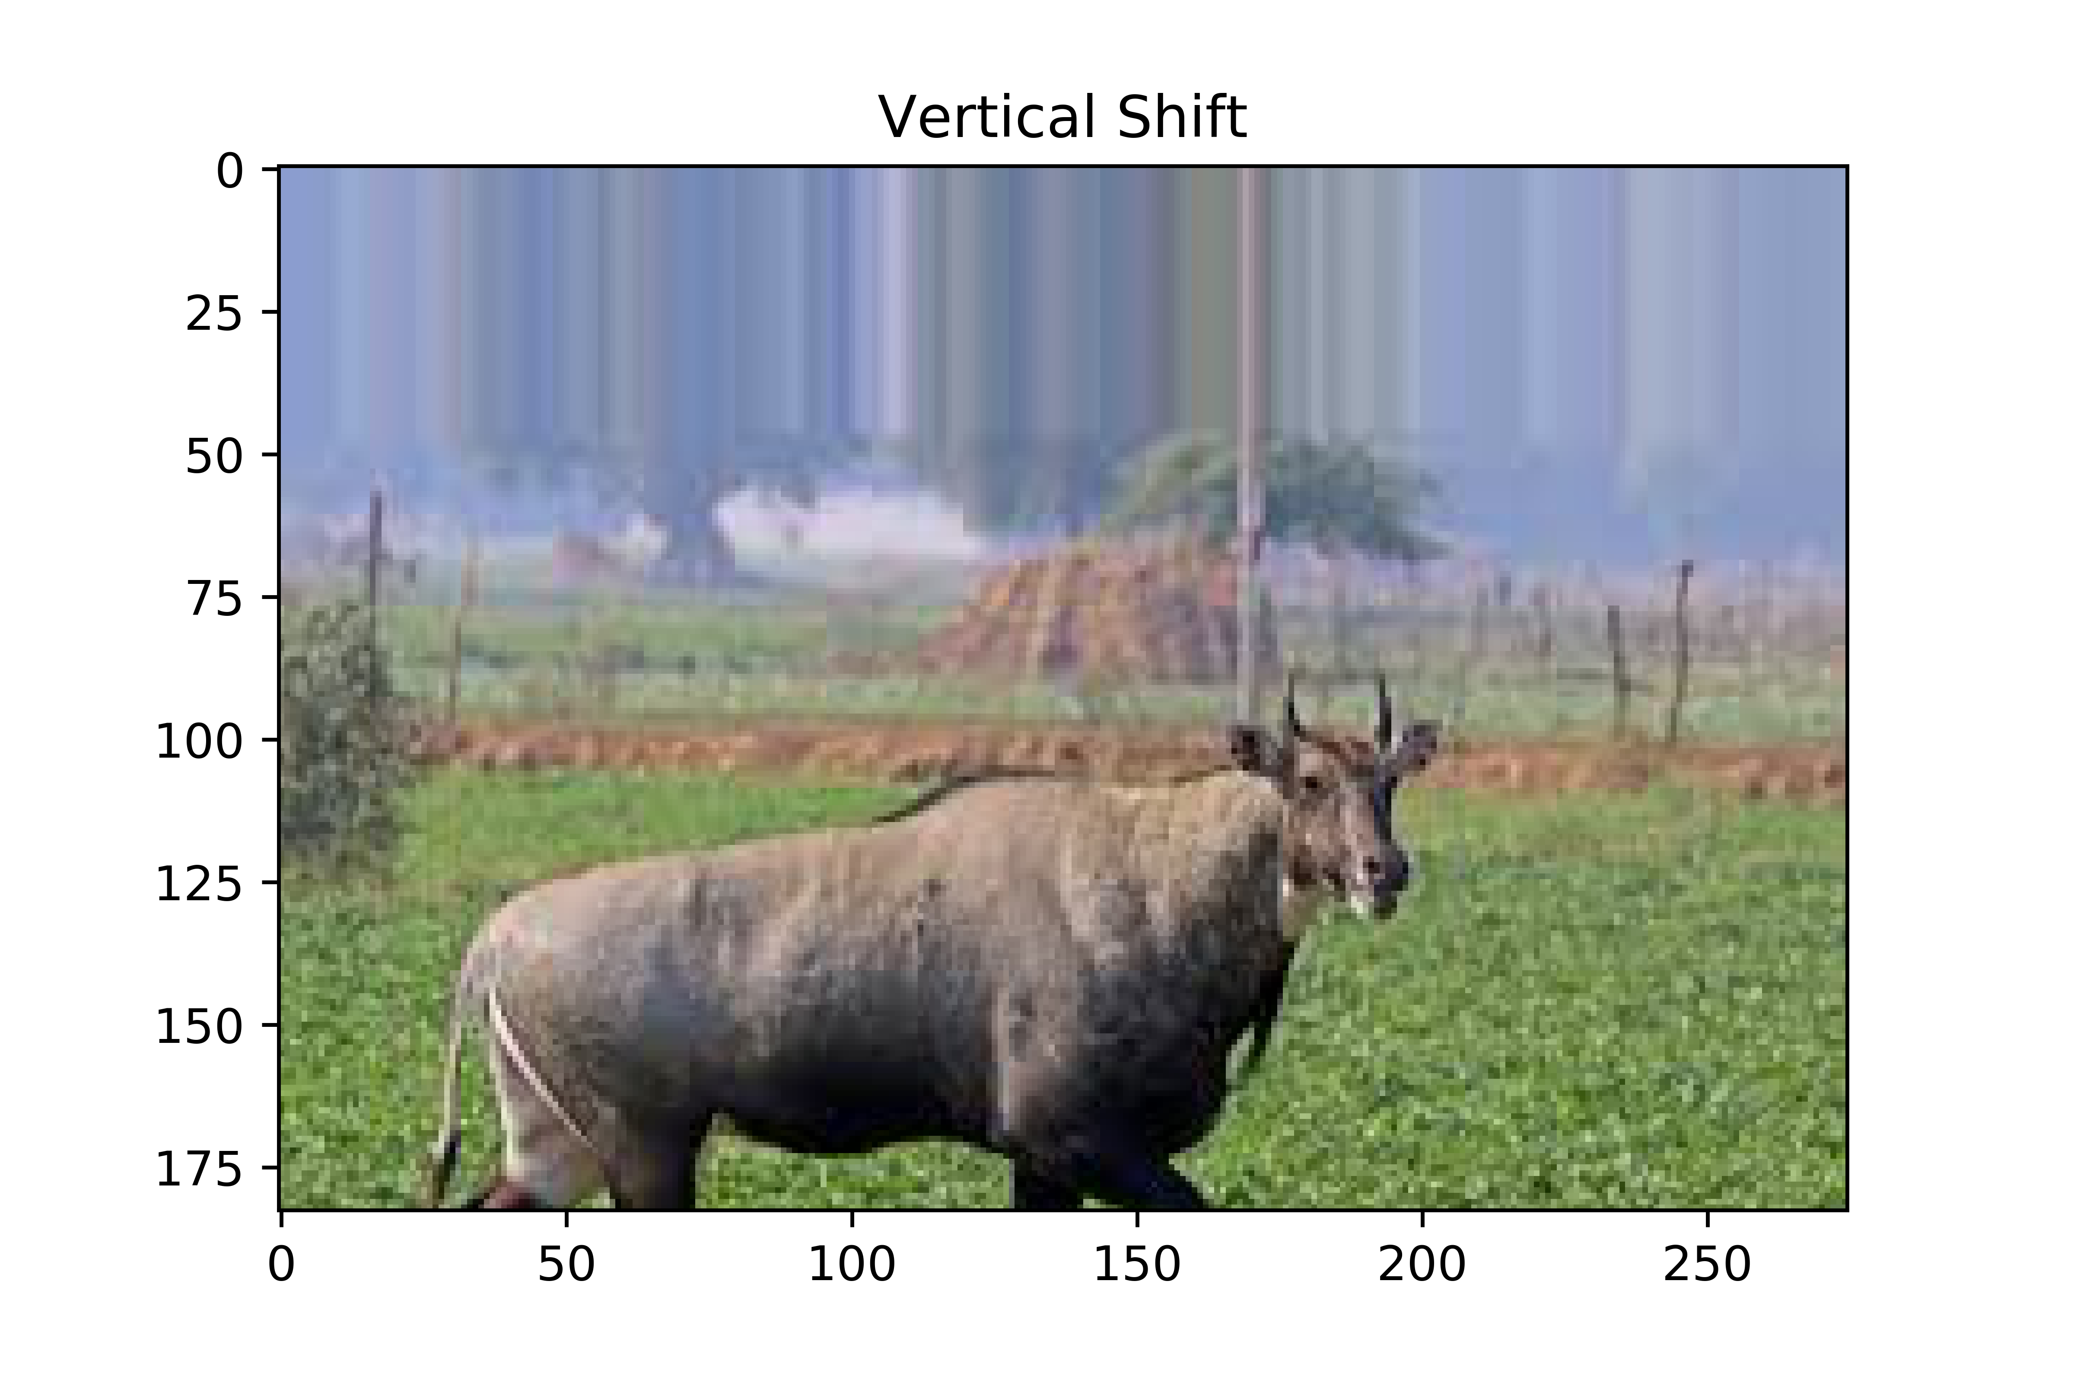
Data Augmentation Types
1. Horizontal/Vertical shift
datagen = ImageDataGenerator(width_shift_range=[-50,50])

Slide 11
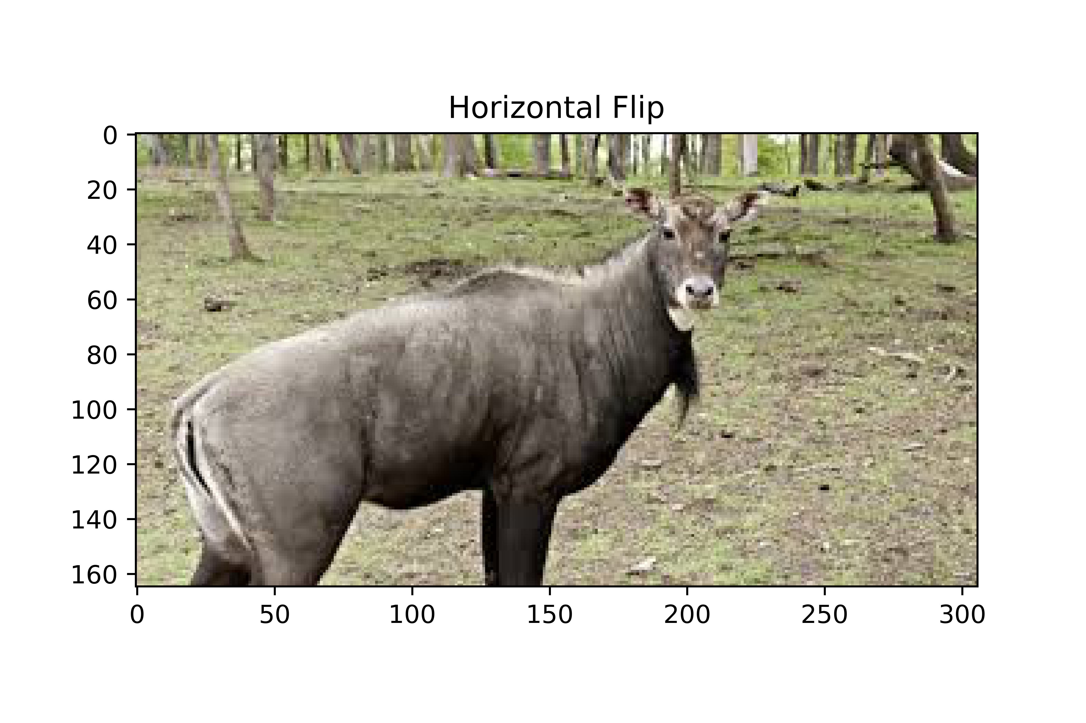
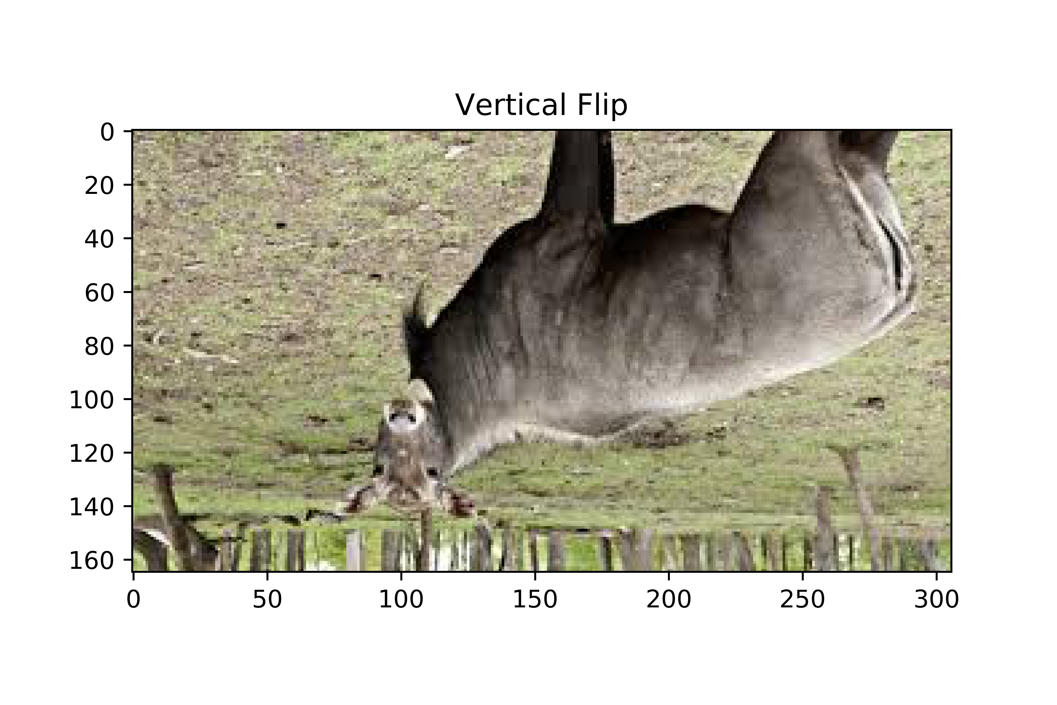
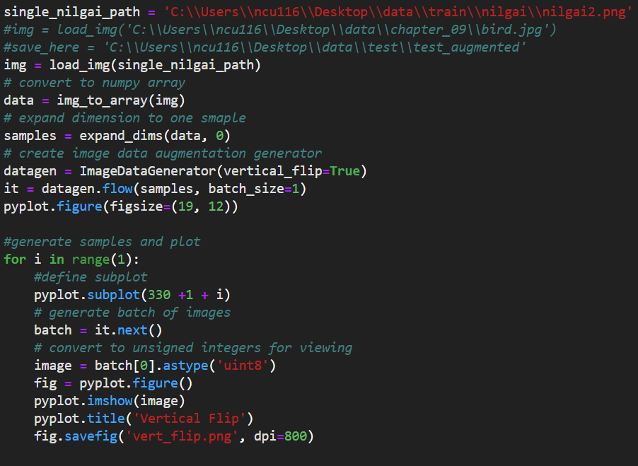
Data Augmentation Types
2. Horizontal/Vertical flip
datagen = ImageDataGenerator(vertical_flip=True)

Slide 12
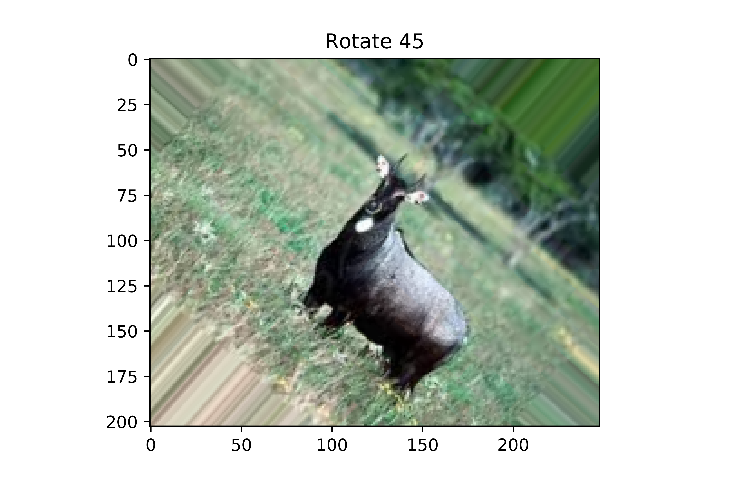
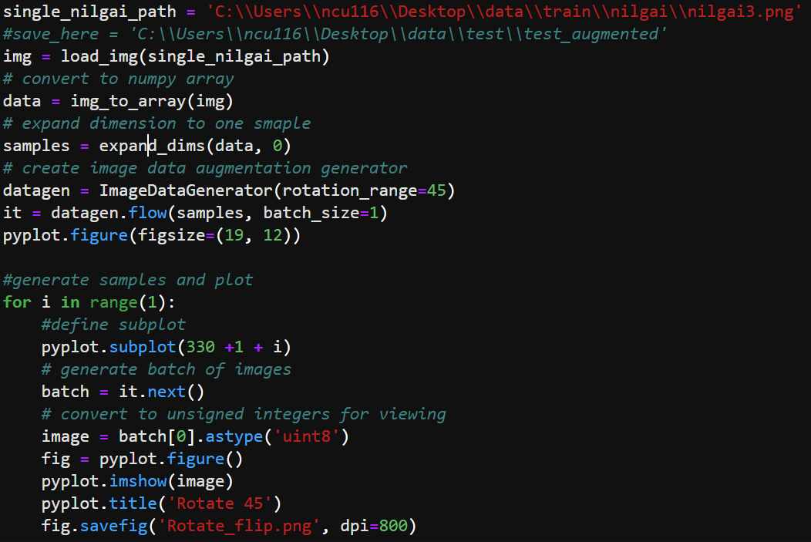
Data Augmentation Types
3. Random Rotation
datagen = ImageDataGenerator(rotation_range=45)

Slide 13
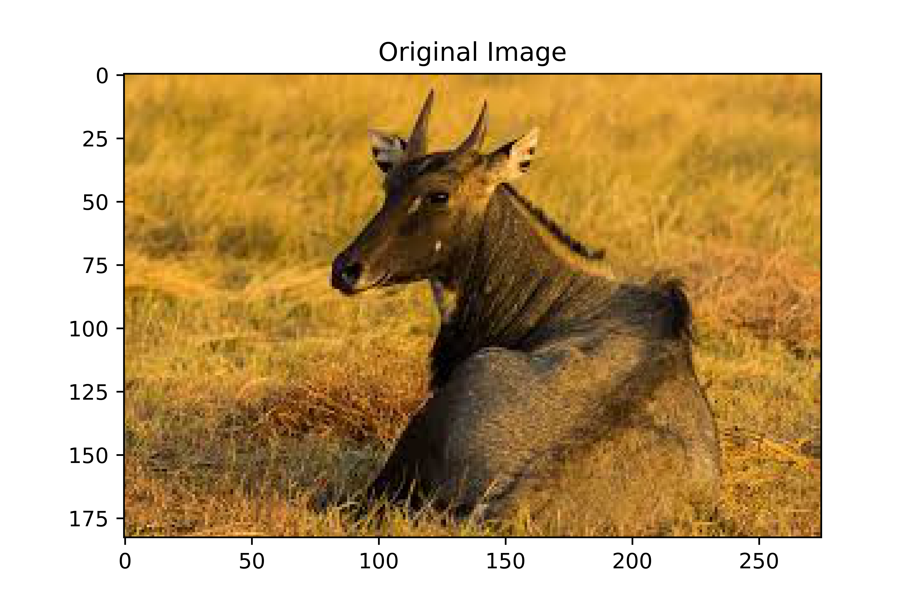
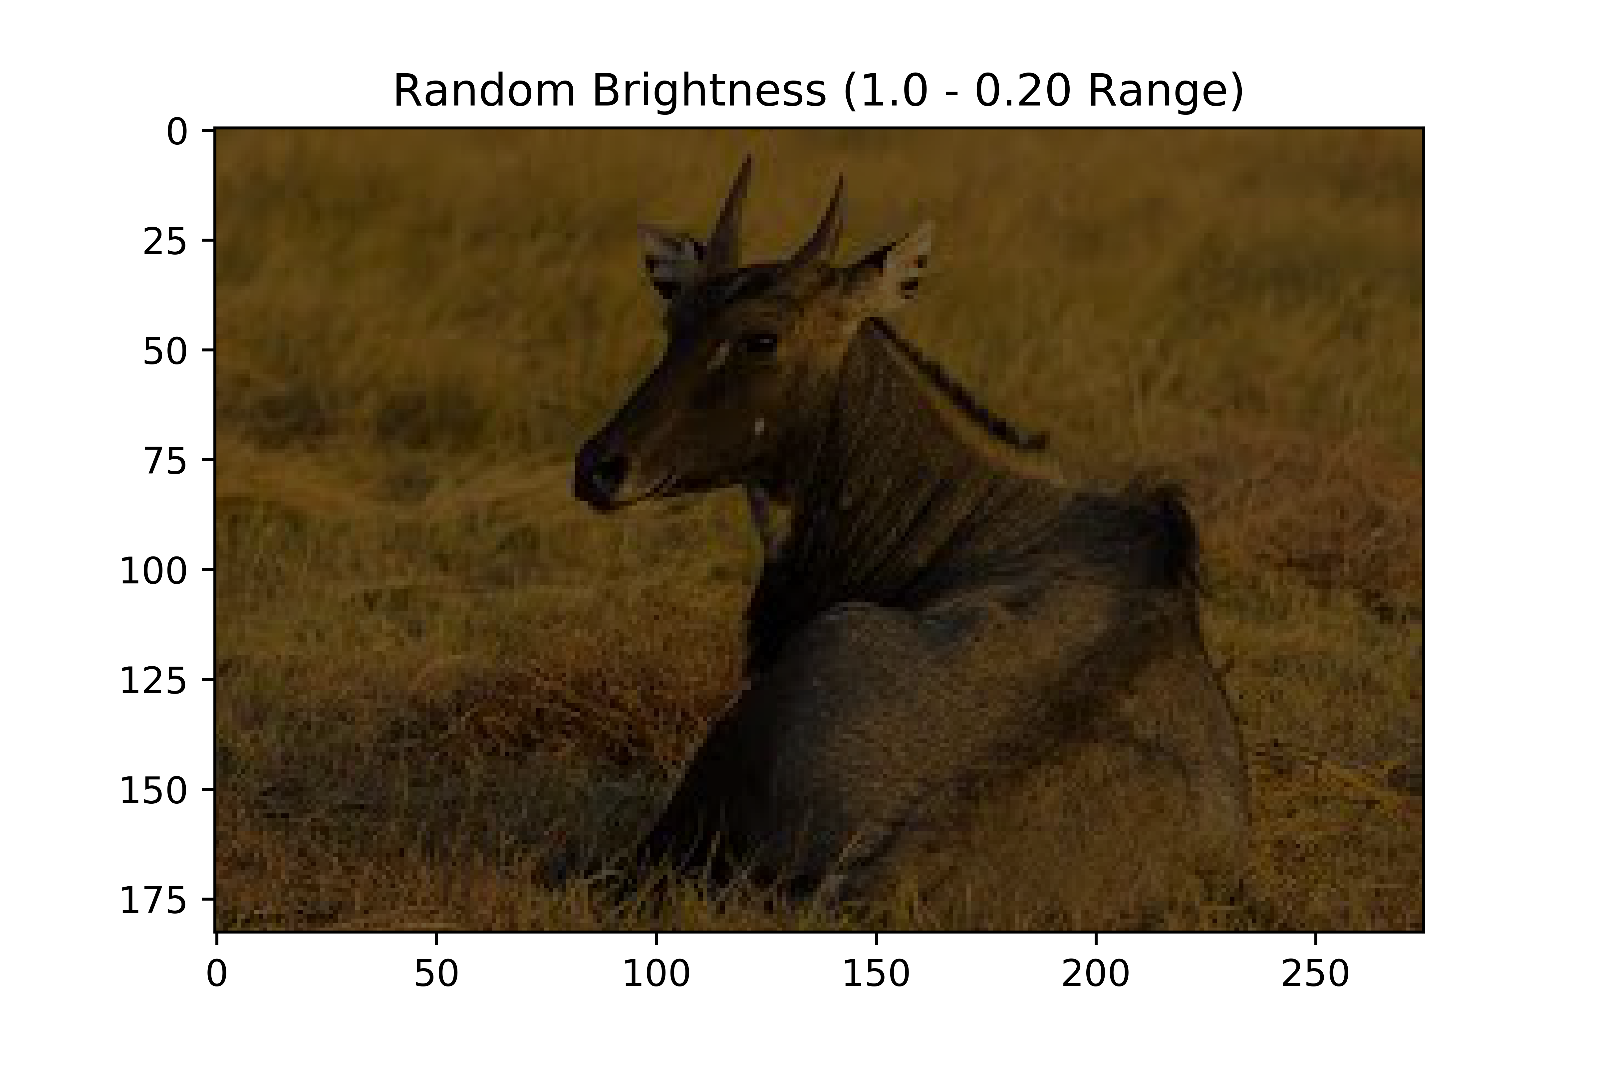
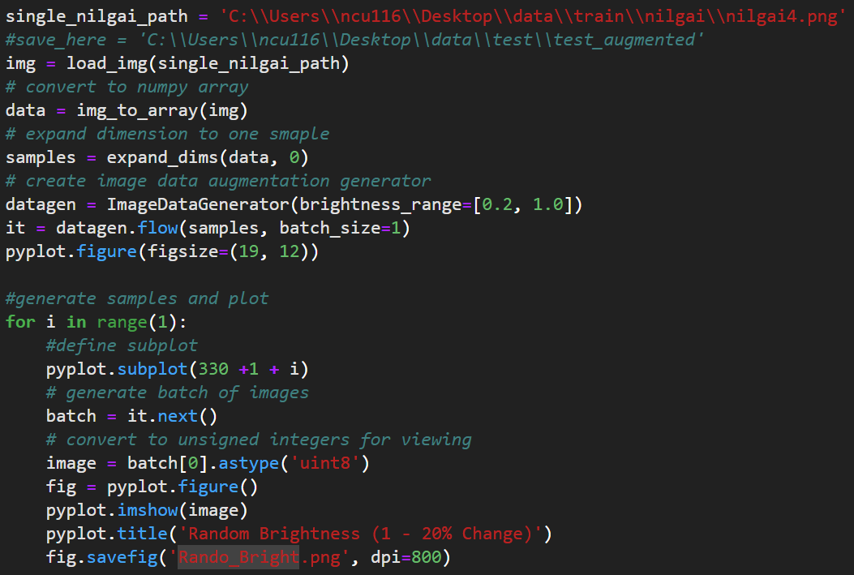
Data Augmentation Types
4. Random Brightness
datagen = ImageDataGenerator(brightness_range[0.2, 1.0])

Slide 14
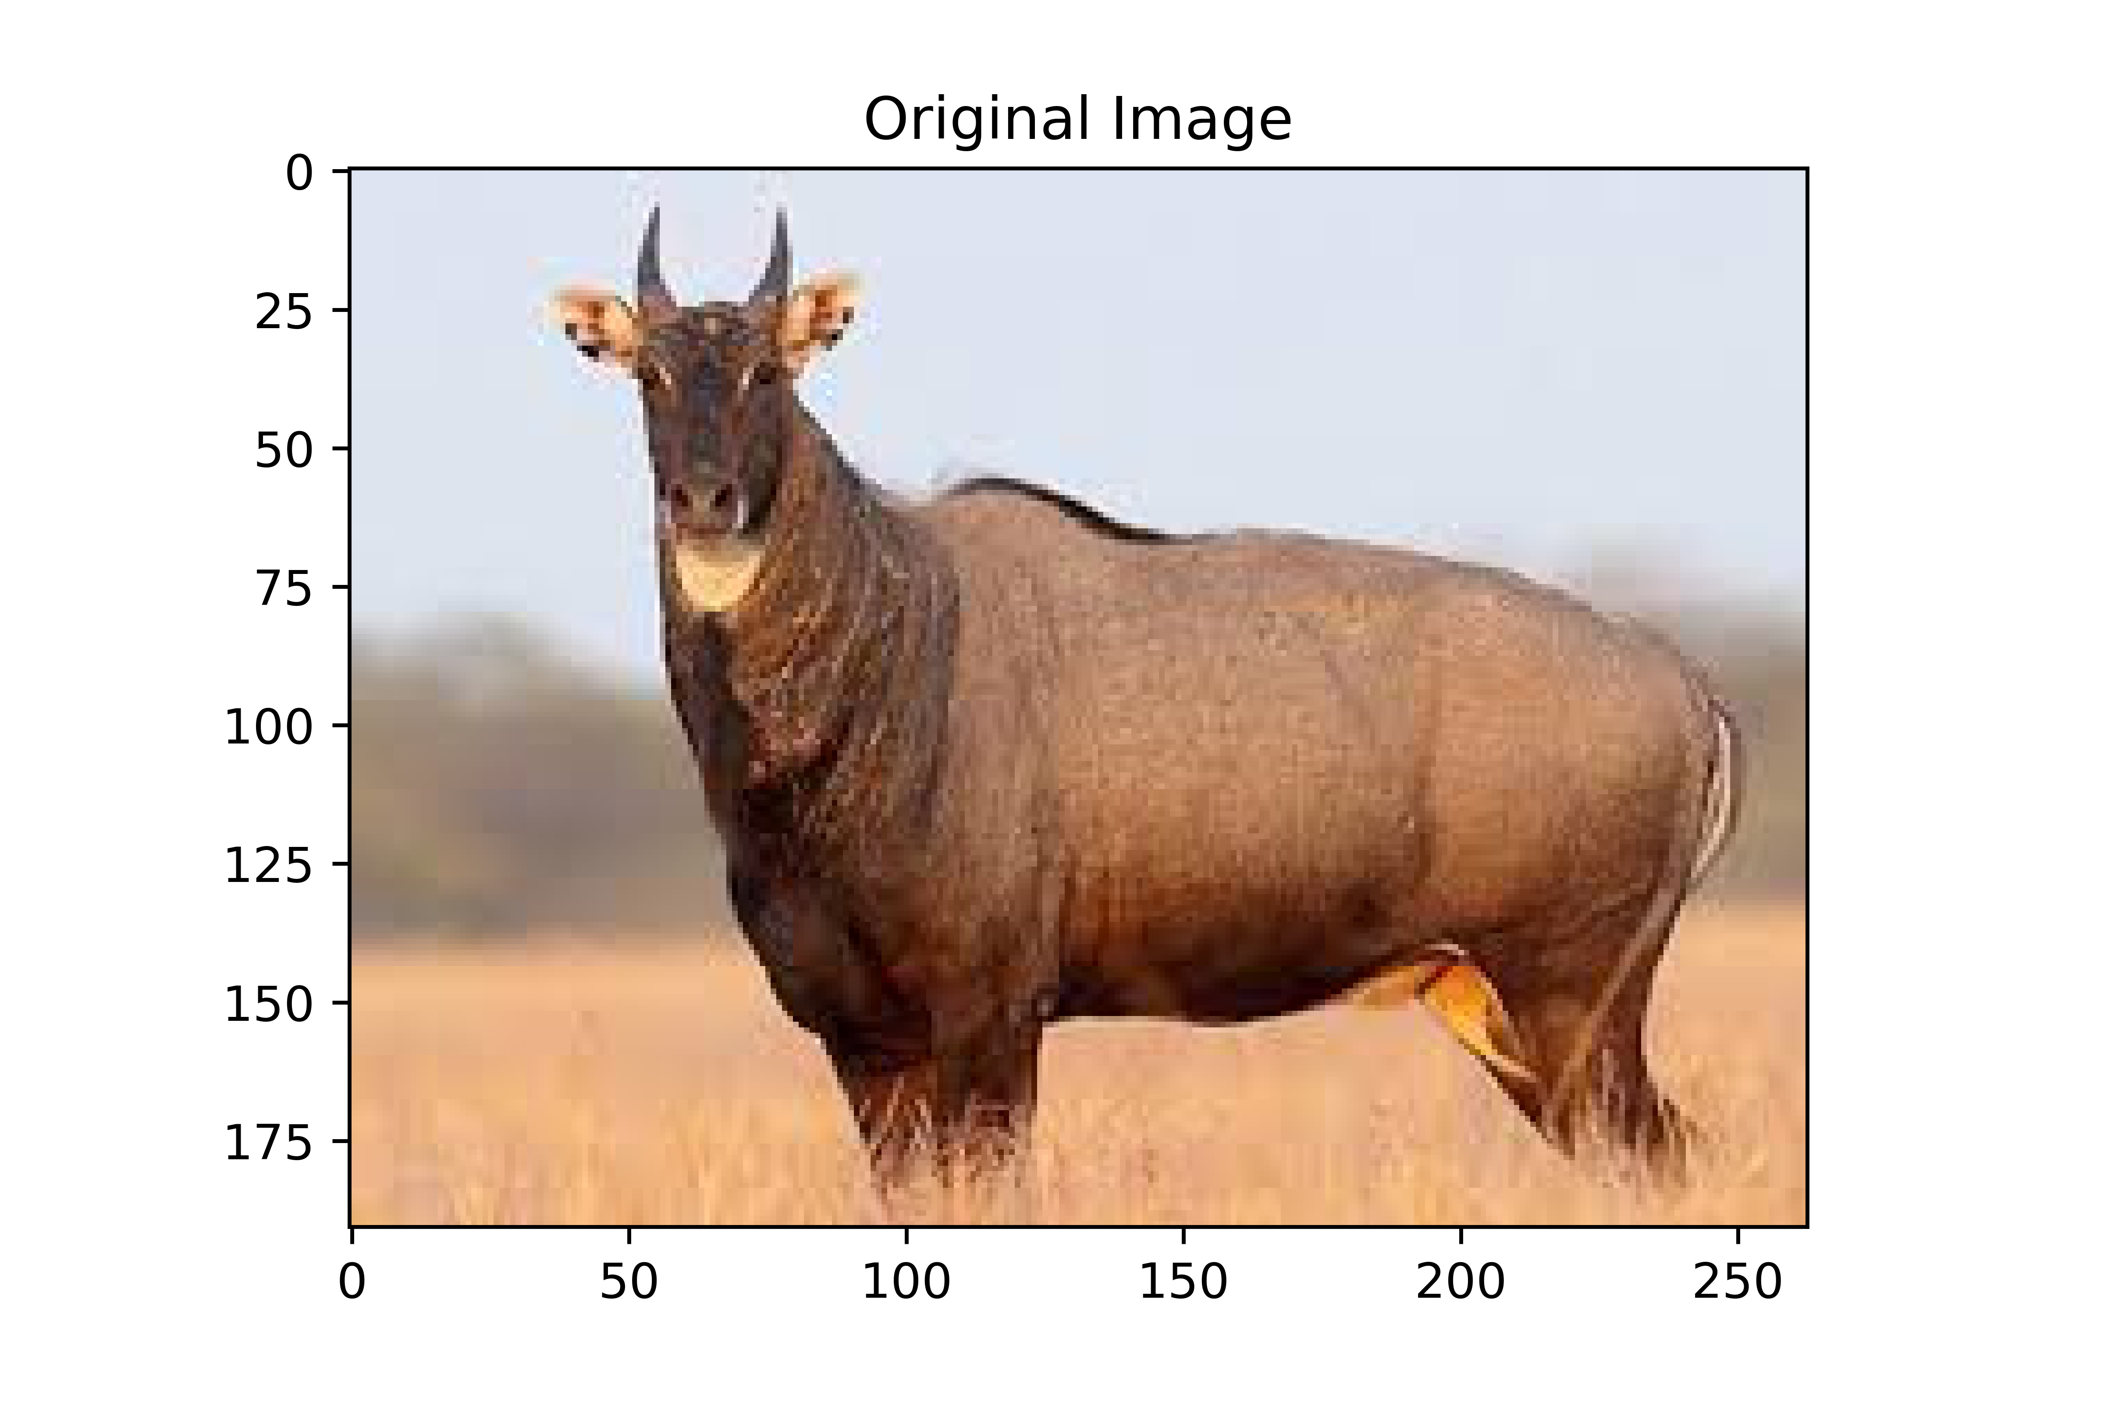
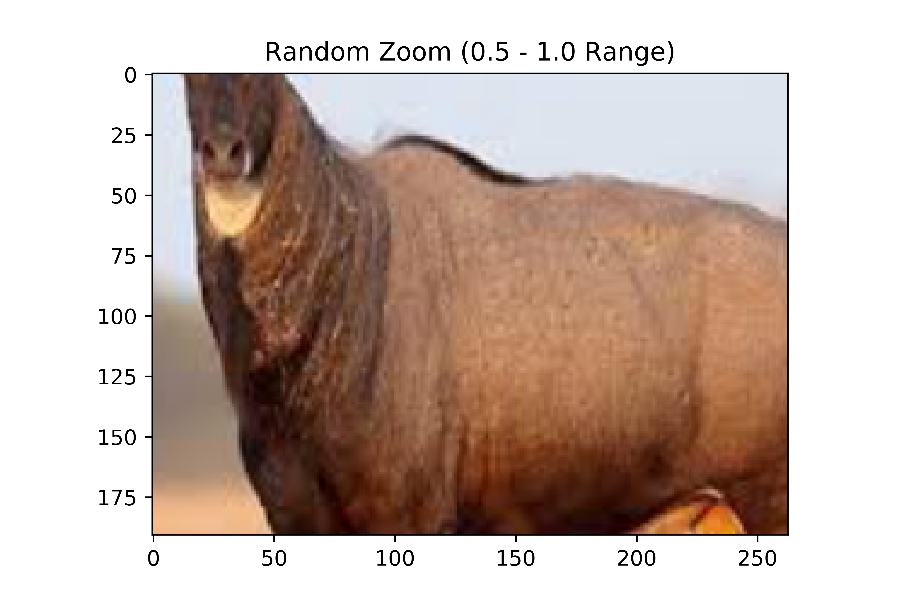
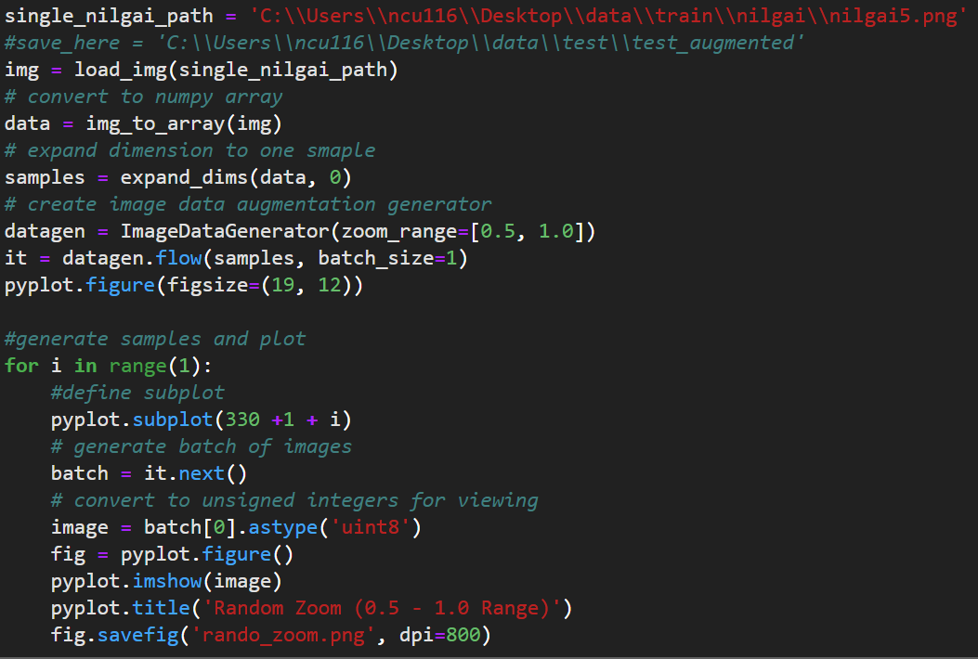
Data Augmentation Types
5. Random Zoom
datagen =
ImageDataGenerator(zoom_range[0.5, 1.0])

Slide 15
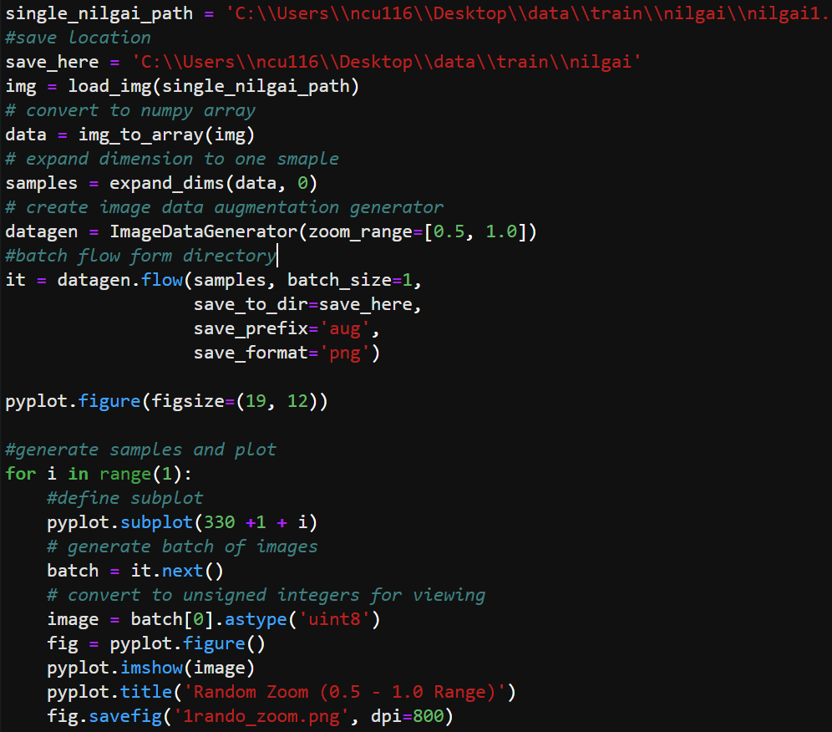
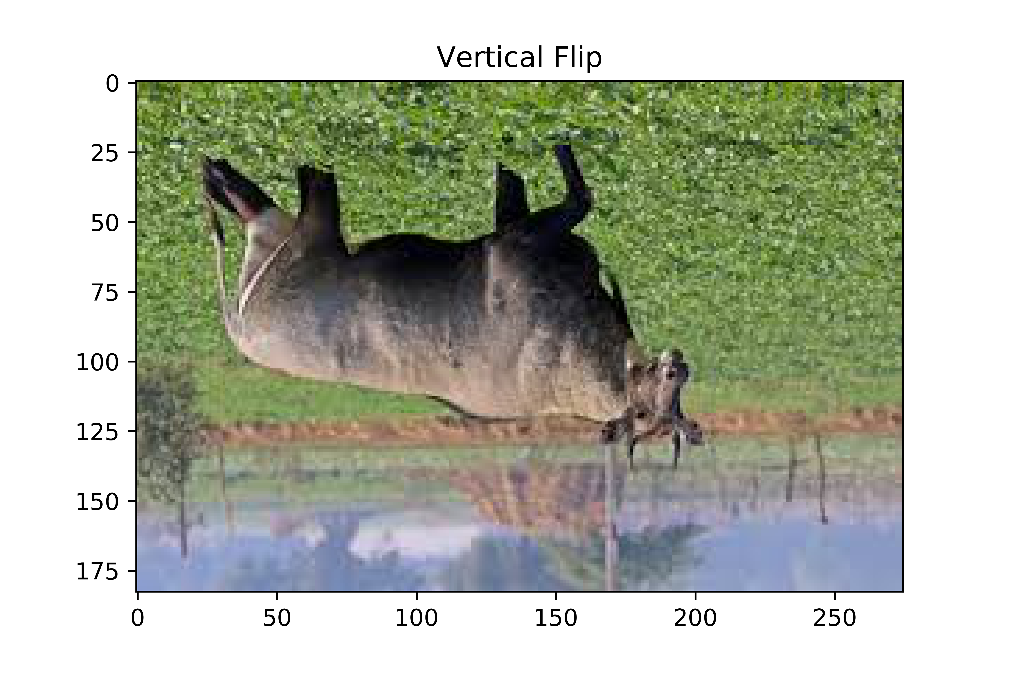
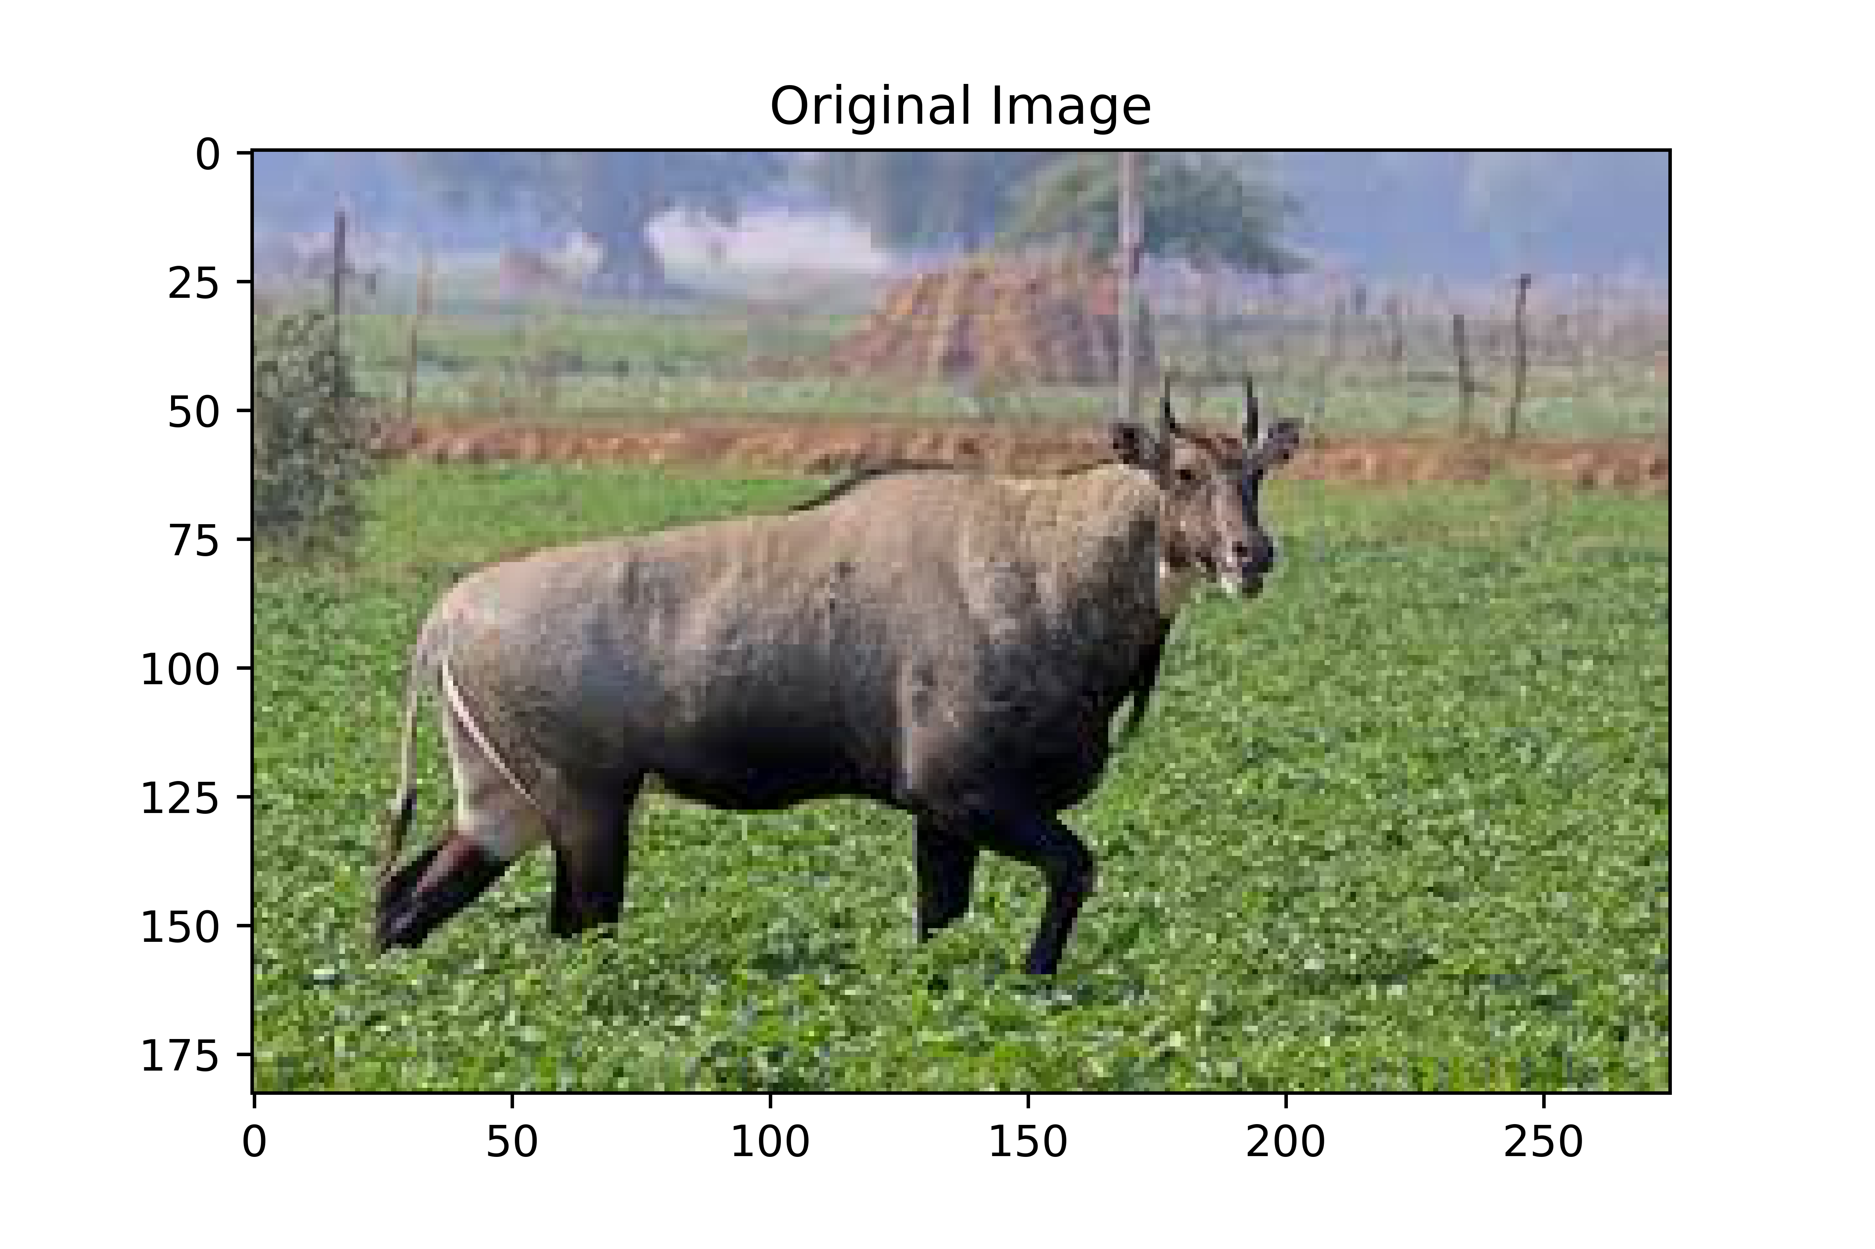
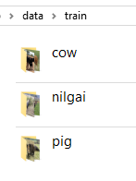
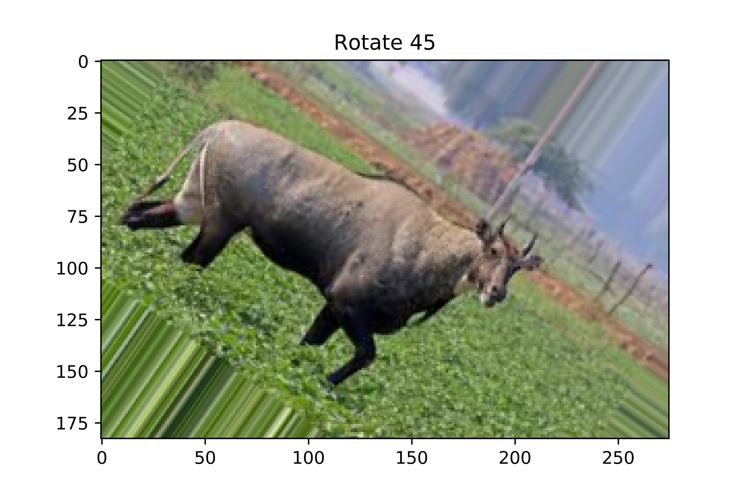
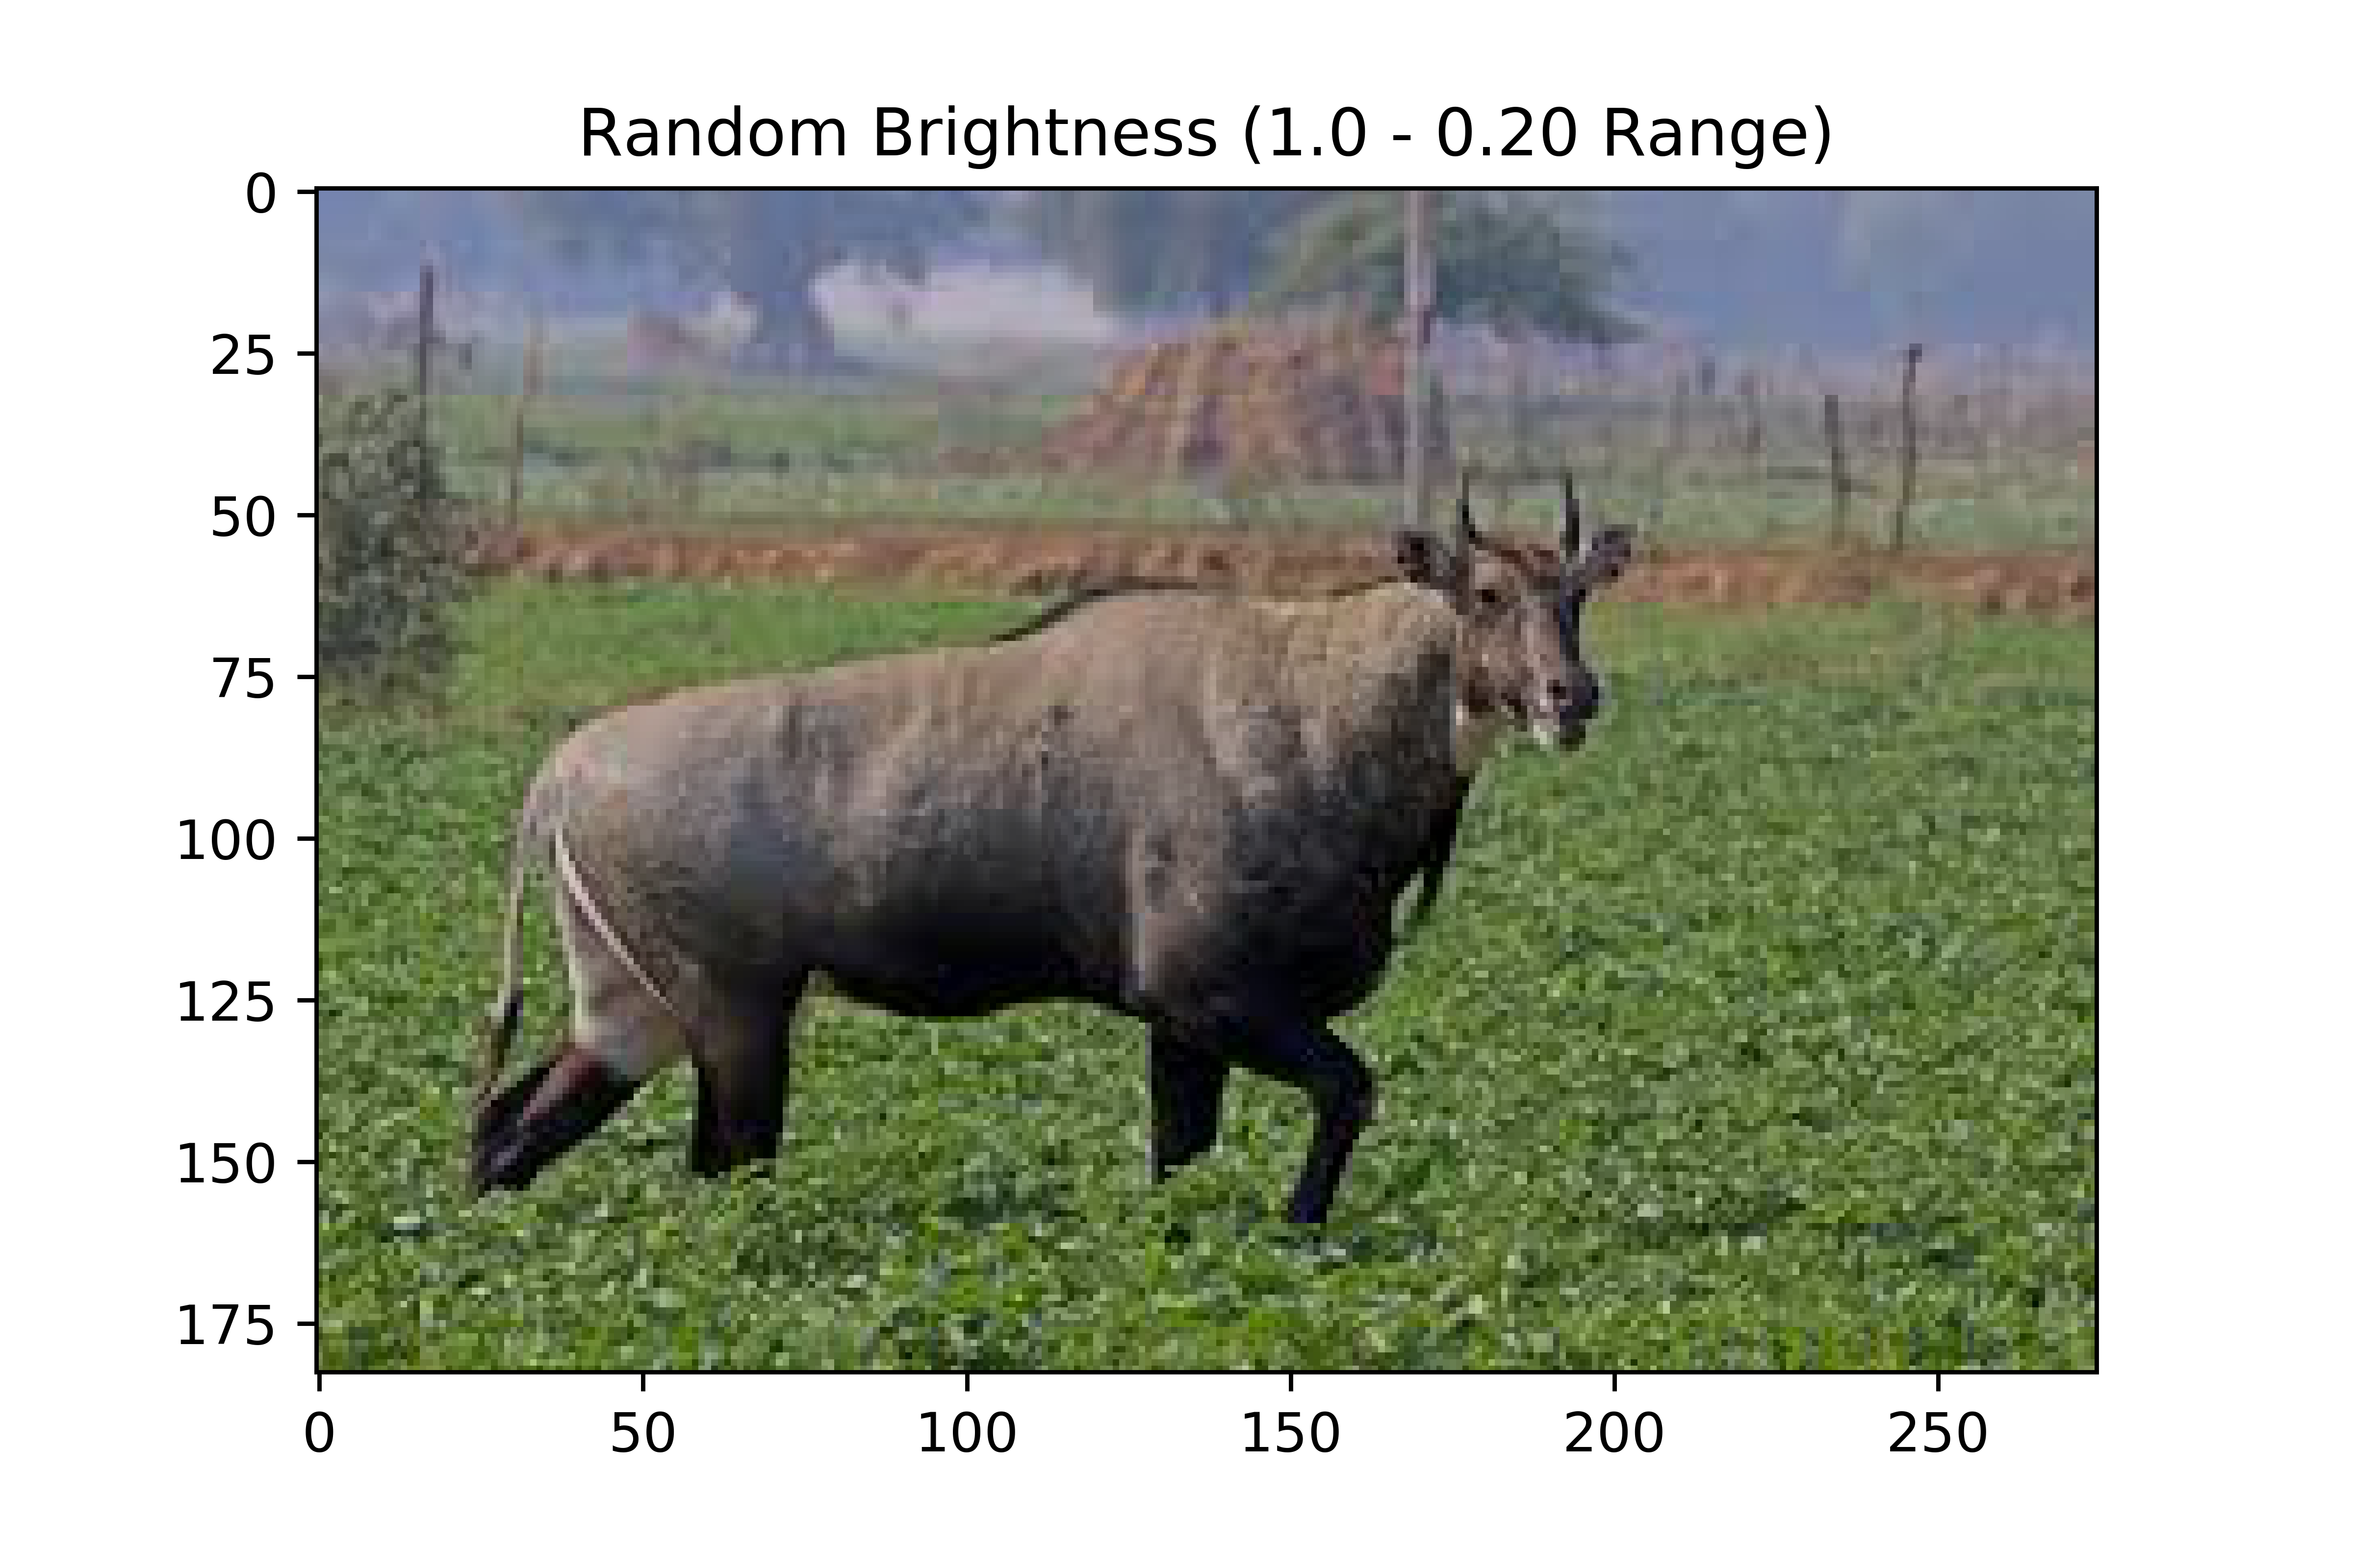
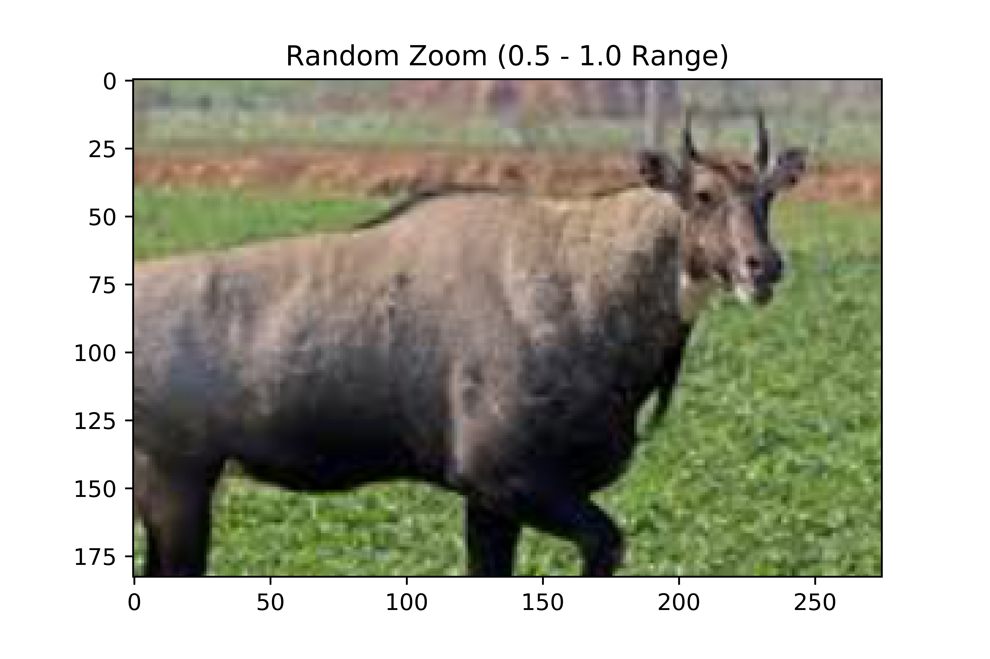
Results: Data augmentation
Save location ‘train’
‘save’ argument in .flow method
360 image training data saved to directory
1
+
5
x
60
=

Slide 16
Results and Next Step:
Generate batches of tensor image data with real-time data augmentation. The data will be looped over (in batches)
Image now tensor object iterable by model
Can now be applied to train classifier

Slide 17
Questions?

Slide 18
What is a validation set?
– Training set: A set of examples used for learning, that is to fit the parameters of the classifier.
– Validation set: A set of examples used to tune the parameters of a classifier, for example to choose the number of hidden units in a neural network.
– Test set: A set of examples used only to assess the performance of a fully-specified classifier.
— Brian Ripley, page 354, Pattern Recognition and Neural Networks, 1996

Slide 19
What is a tensor?
A tensor is a generalization of vectors and matrices to potentially higher dimensions
“Tensors are matrices of many dimensions”
— Emmanuel Caradec, Understanding Keras Tensors, 2018
Deep learning usually involves hundreds, if not thousands, of dimensions and fields.
Best represented by tensors since they can represent anything ranging from zero to N dimensions.
Images can easily be broken down into a few hundred features. Therefore, tensors can be best viewed as containers that wrap and store data features in the context of machine learning and deep learning.
— CE Kan, Quick ML Concepts: Tensors, 2018

